Slide 1
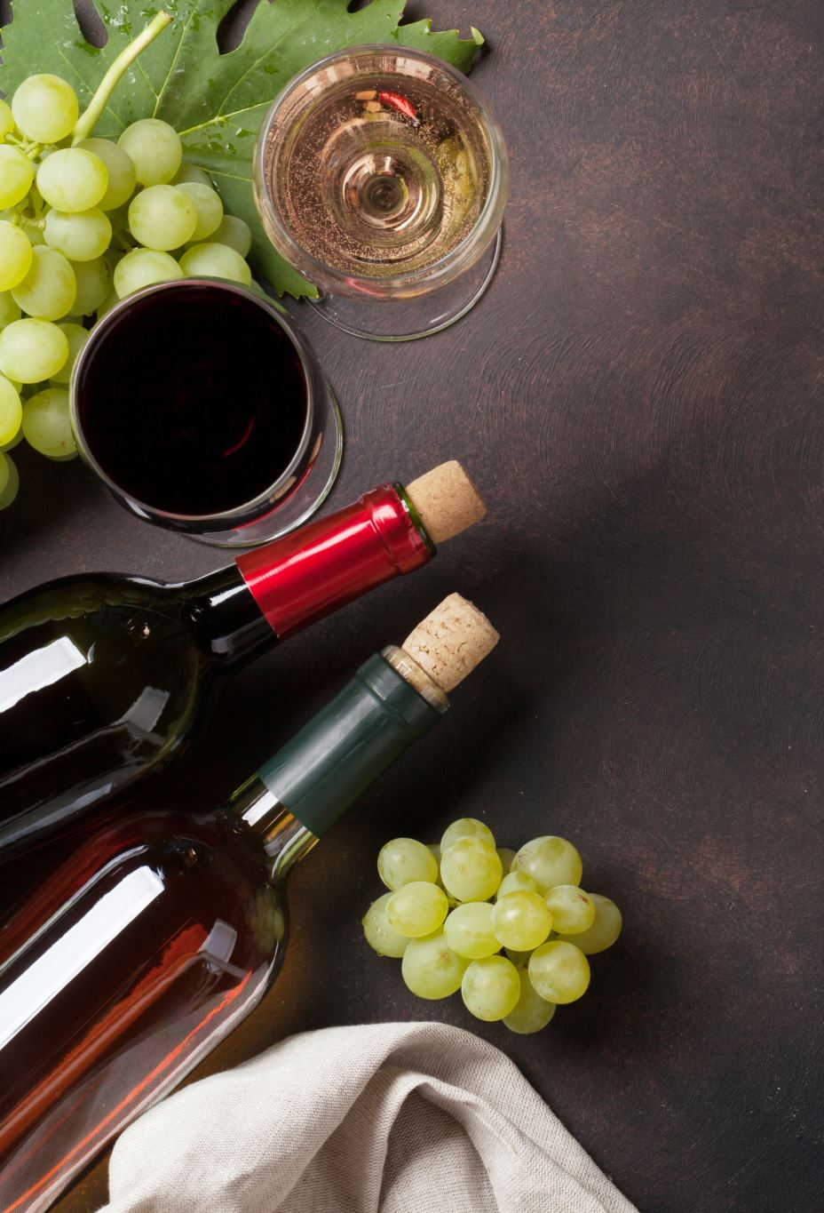
Wine Quality Prediction & Analysis
Karthik Radhakrishnan

Slide 2
Introduction
Objective
Build a model to predict wine quality & minimize Mean Absolute Error (MAE) on the test set.
Identify key factors that contribute to high-quality wine, providing actionable insights for vintners to enhance their production processes.
Data
Data contains 11 features that can influence wine quality such as Acidity levels, Sugar Content, Alcohol content & pH Level along with response variable ‘Quality’.
Data is measured by objective tests and the output is based on sensory data (median of at least 3 evaluations made by wine experts).
Contains 5463 observations

Slide 3

Wine Quality Prediction

Slide 4
Approach
Determine the applicable models based on relationship between features and response variable ( knn vs linear regression vs Random forest).
Build the applicable models, evaluate and compare the performance based on MAE and accuracy.
Choose the model with best MAE for predicting the wine quality.

Slide 5
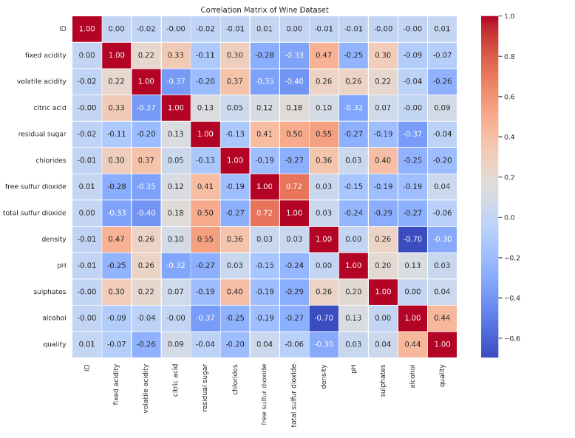
Exploratory Data Analysis
Assessment of Multicollinearity
free sulfur dioxide and total sulfur dioxide have high
positive correlation
Alcohol and Density have high negative correlation
Note: Response variable ‘quality’ is ordinal variable hence assessing correlation with it is not appropriate.

Slide 6
Model Selection
Model | Accuracy | MAE
knn | 49 % | 0.636
Random Forest | 73 % | 0.295
Random forest model with hyper parameter tuning showed significant improvement in Mean Absolute Error (MAE)
and Accuracy when compared with knn algorithm, hence random forest model is used to predict the wine quality.
Notes:
1. Steps – First simple random forest model, Addressed class imbalance, did hyper parameter tuning

Slide 7
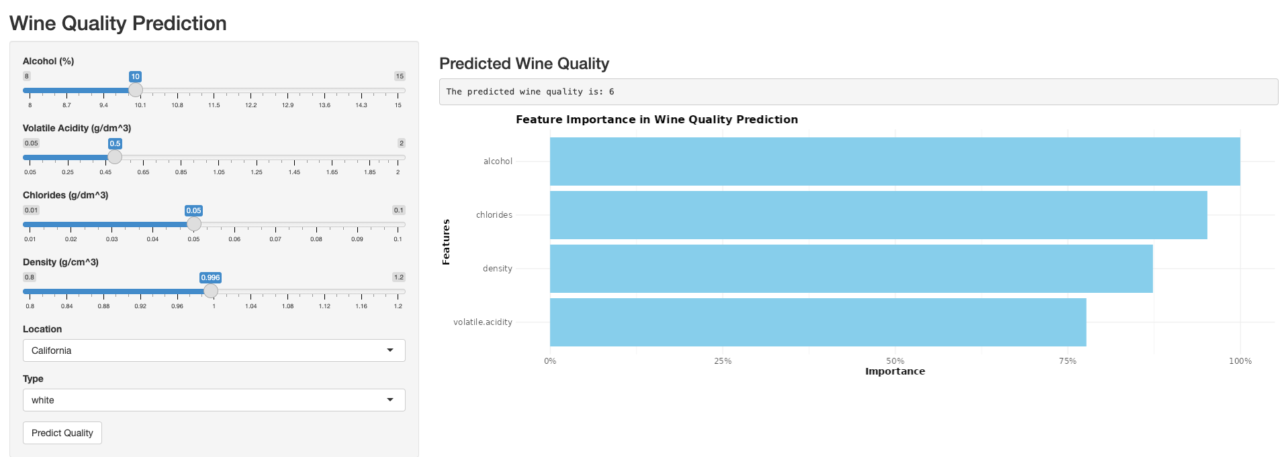
Interactive Visualization
Rshiny dashboard is built based on random forest model to predict wine quality given certain specifications.
https://datafusion.shinyapps.io/Wine_Quality_Prediction/

Slide 8
Data Analysis
Determine key factors that contribute to high quality wine

Slide 9
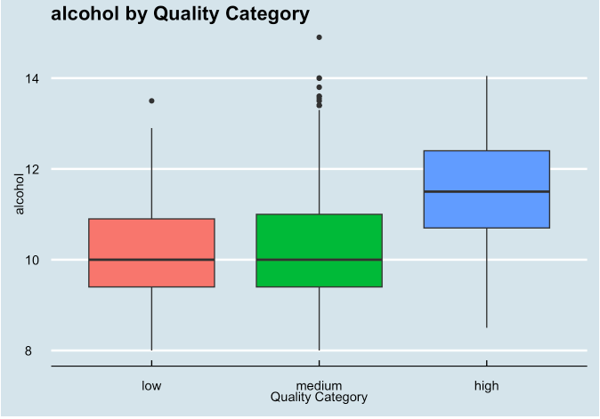
Alcohol
Insight
Higher alcohol content is strongly associated with higher quality wines.
Recommendation
Aim for higher alcohol content, around 11-13%, by ensuring proper sugar levels in grapes and complete fermentation.

Slide 10
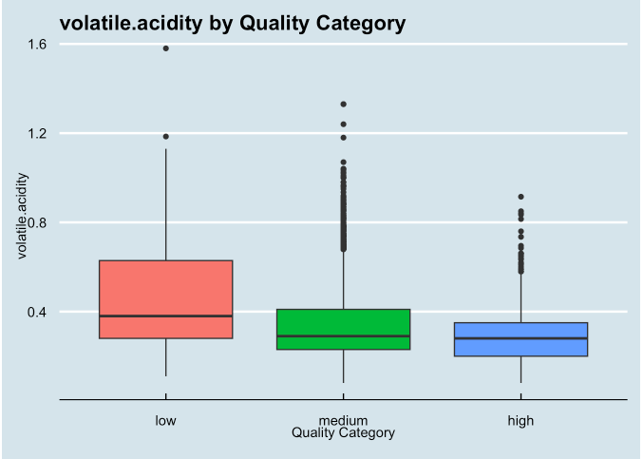
Volatile Acidity
Insight
Lower volatile acidity is strongly associated with higher quality wines.
Recommendation
Keep volatile acidity low, ideally below 0.4 g/L, by managing fermentation conditions and bacterial activity.

Slide 11
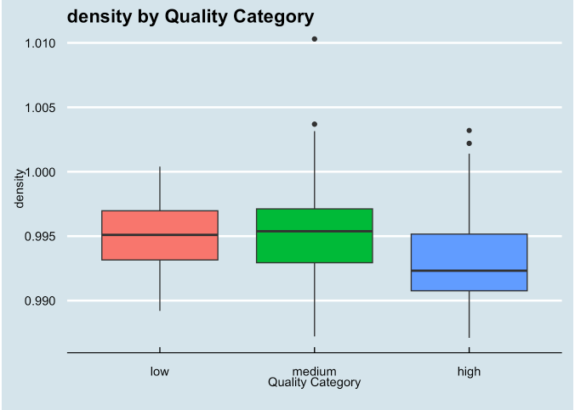
Density
Insight
Lower density is associated with higher quality wines.
Recommendation
Aim for lower density by ensuring complete fermentation and managing alcohol content.

Slide 12
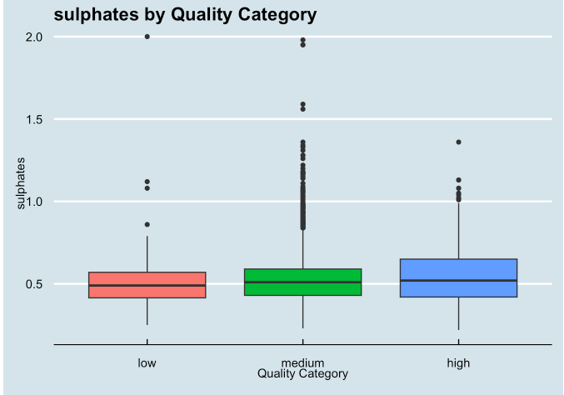
Sulphates
Insight
Higher sulphate levels are associated with better quality wines.
Recommendation
Consider slightly higher sulphate additions, around 0.5-0.7 g/L, which may act as antioxidants and antimicrobials.

Slide 13
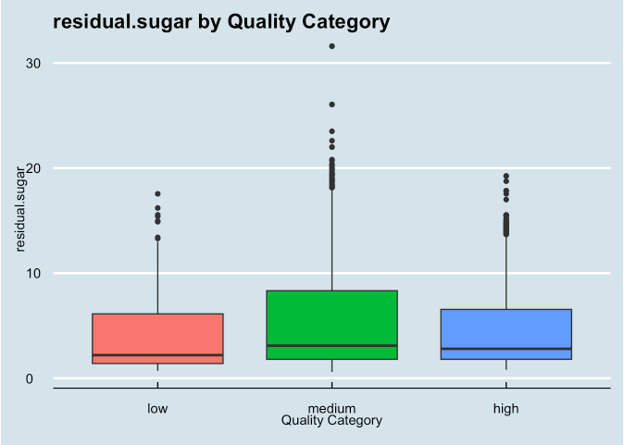
Residual Sugar
Insight
No clear trend, but high-quality wines have less variation. Sugar content itself doesn't determine quality, but consistency might be important.
Recommendation
Focus on consistency in residual sugar levels based on the desired wine style.

Slide 14

Recommendations for Vintners
Focus on
Focus on minimizing volatile acidity through proper fermentation management and hygiene practices.
Aim
Aim for complete fermentation to achieve higher alcohol content and lower density.
Consider
Consider slightly higher sulphate additions for their potential positive impact on wine quality.
Ensure
Ensure consistent sugar levels in grapes and manage fermentation to achieve desired alcohol content.

